Slide 1
Data Analysis Report
AdventureWorks
Presented by
Selorm Hodo
12/07/2022

Slide 2
Project Description
The AdventureWorks Database provided by Microsoft supports a fictitious, multinational manufacturing company called Adventure Works Cycles.
The company wants to improve on their Internet Sales reports from static reports to visual dashboards for use by the CEO and CMO.
Analysis are provided for 2 years back(2019-2020) to guide 2021 operations.
Company sales performance is measured against budgeted sales .

Slide 3
Business Problem
1. To provide Dashboard overview for the CEO about internet sales so as to follow:
Sales over the period and trends in sales.
Top 10 Customers.
Top 10 Products.
2. To provide detailed Dashboard overview of customers and products for CMO that allows to
filter data for customers and Products to develop more effective promotions.

Slide 4
Summary about database
The Adventure Works database was restored in Microsoft SQL Sever
Based on the project description and business problems the following tables were used for queries : (dimension tables) Date, Customer, Geography, Product, (Fact table) Internet Sales and a budget table for 2020.
Data tables were cleaned to provide error free analysis and transformed by SQL queries.
Relationships between tables were created by creating a model
Calculated required Dax measures(Sales, Budget, sales/budget)
Imported dynamic KPI card
Generated visuals in Power BI

Slide 5
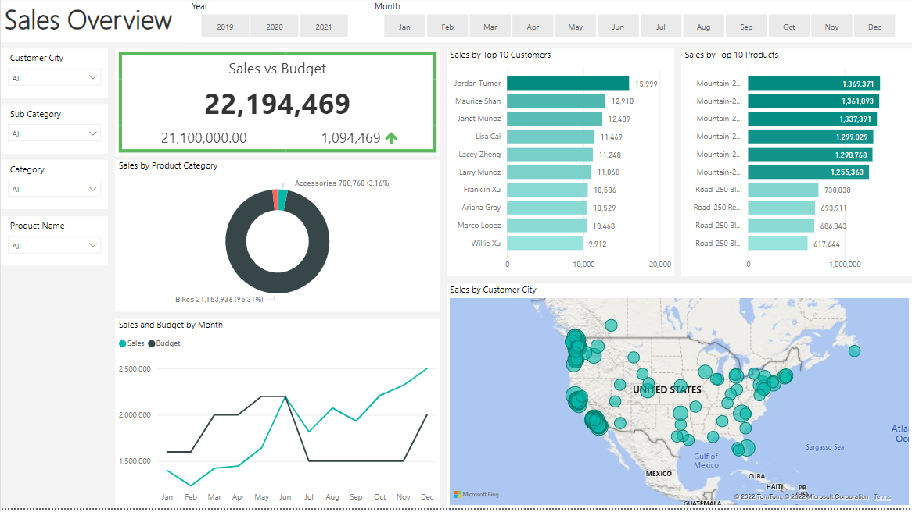
Report Overview for CEO

Slide 6
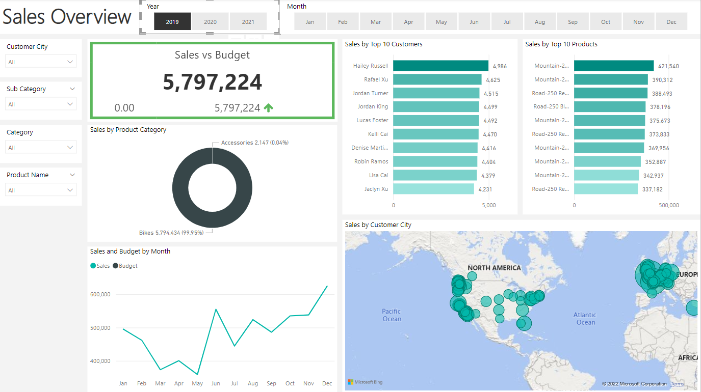
Sales Overview for 2019

Slide 7
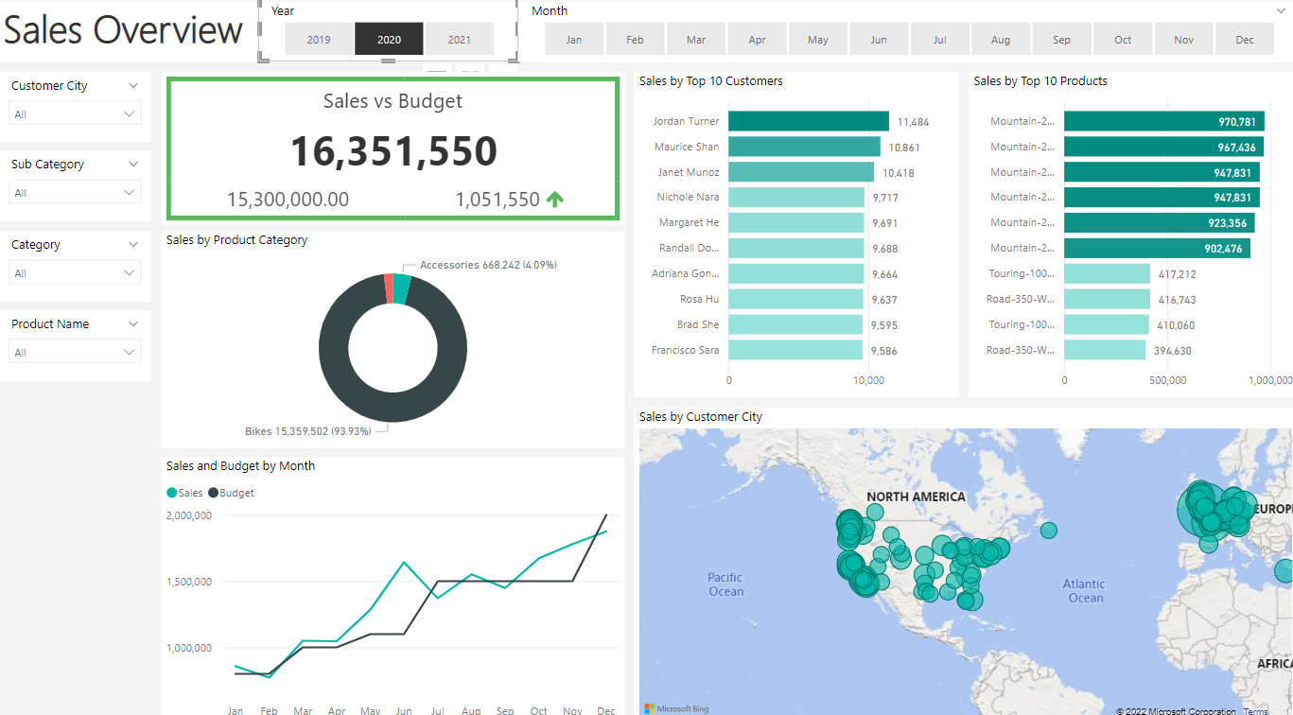
Sales Overview for 2020

Slide 8
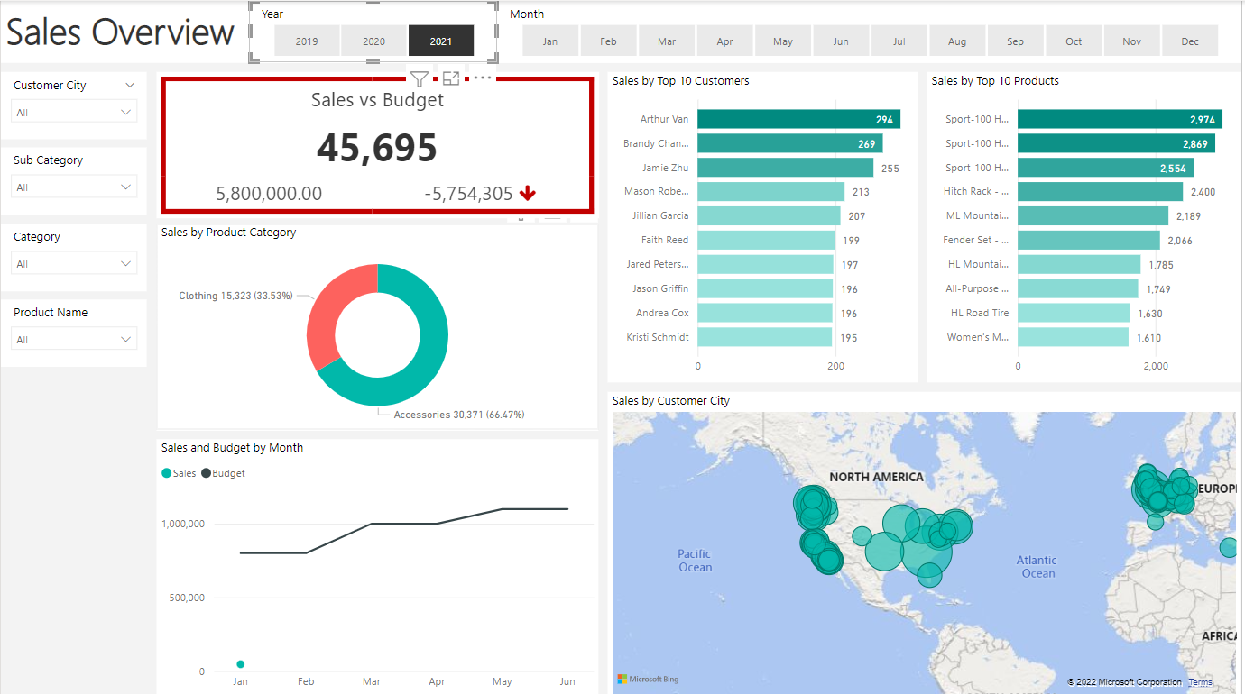
Sales Overview for 2021

Slide 9
Sales insights for CEO
Analysis shows overall sales for the period was above budgeted by 1,094,469
In 2020 the sales figure was 1,051,550 more then the budgeted figures provided
Significant increase in sales from 2019-2020 . From 5,797,224 to 16,351,550.
.

Slide 10
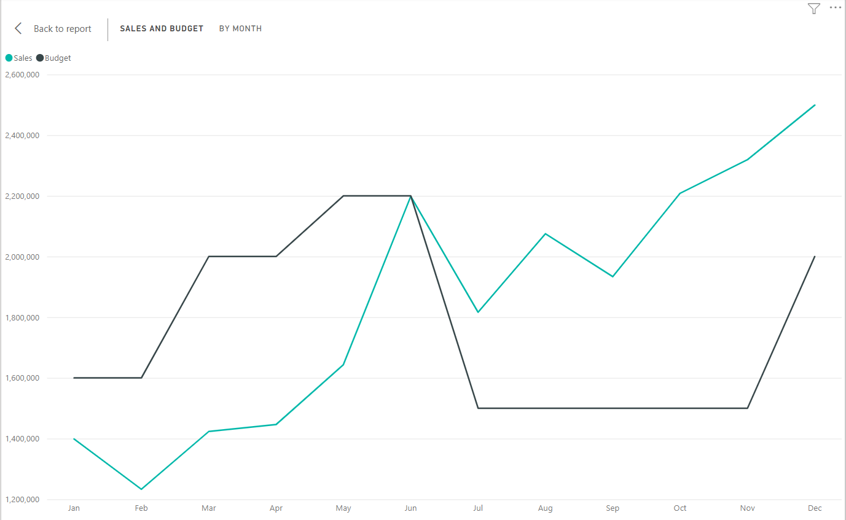
Trend Insights for CEO
The analysis also shows that some months Witnessed exceptional growth.
There was sudden rise in the month of June and December recorded the highest sales . Similar patterns obtained in 2019 ana 2020
This shows the business is impacted with seasonality which occurs in June and Dec. This should aid production planning.

Slide 11
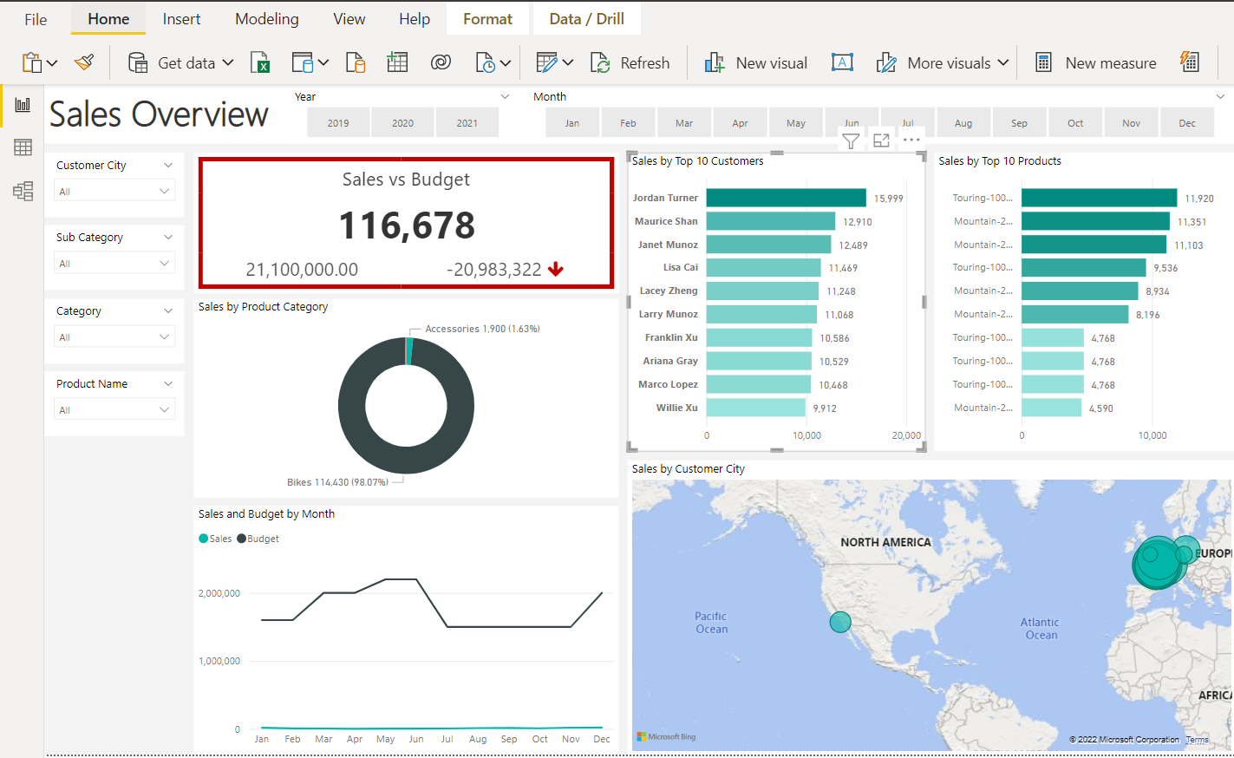
Sales from top ten Customers over the period

Slide 12
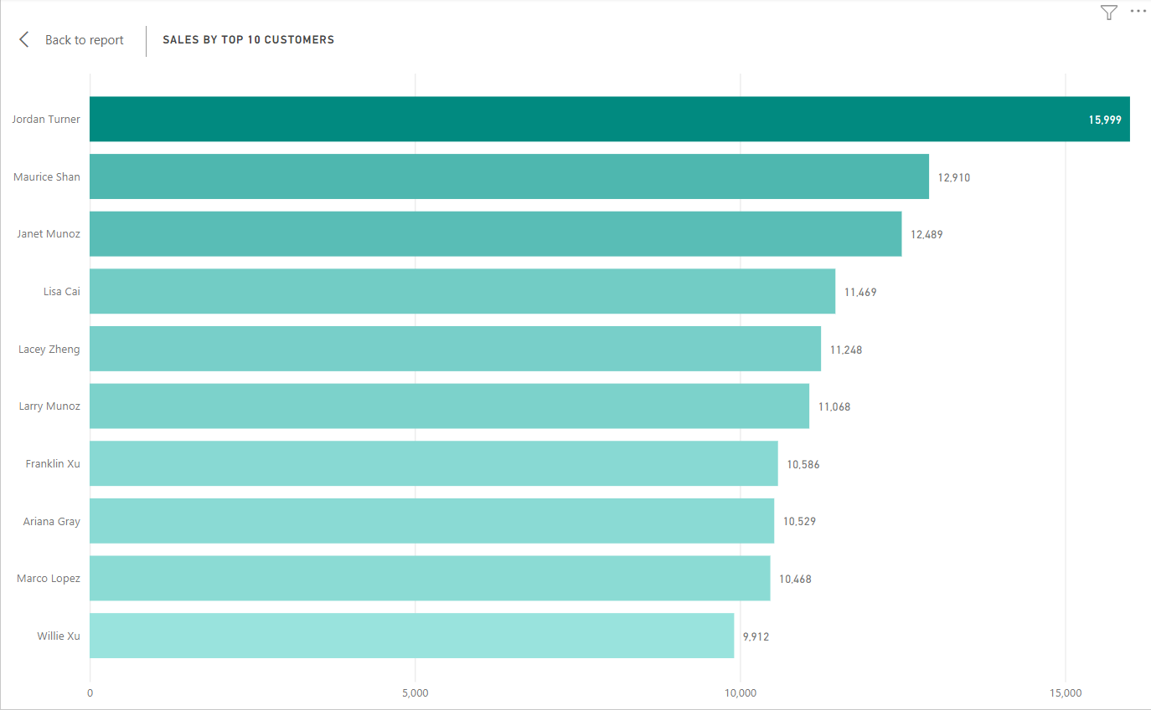
Top 10 Customer Insights for CEO
Sales from top 10 customers
does not show much differences among
them. The highest sales is 15,999 and
second is 12,910 and third is 12,489.
This shows the business is not relying
on a few customers to generate sales
and that the bargain power of
customers is low.

Slide 13
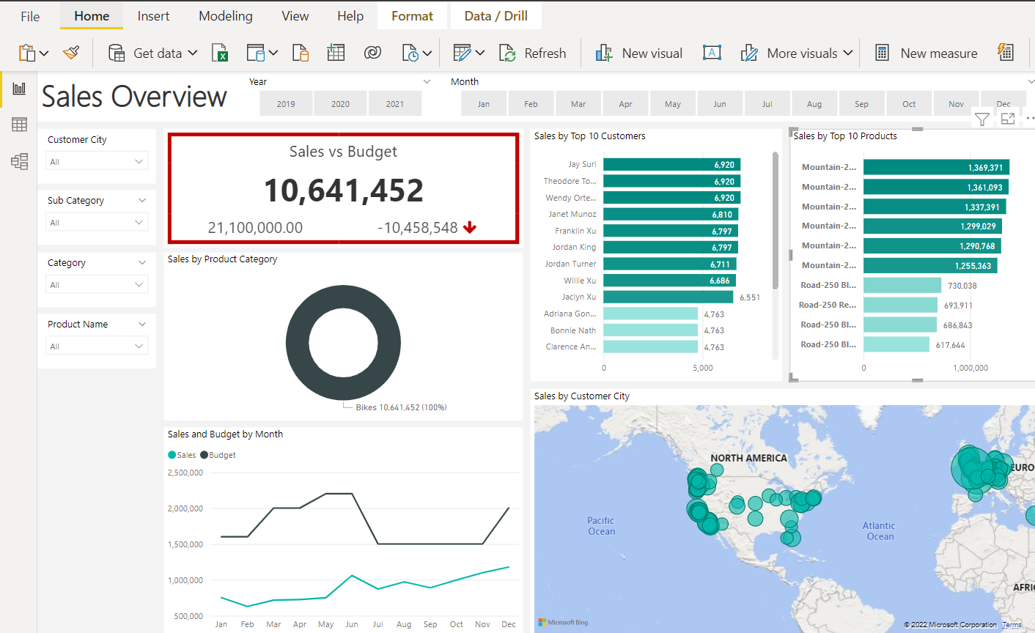
Sales from top 10 products over the period

Slide 14
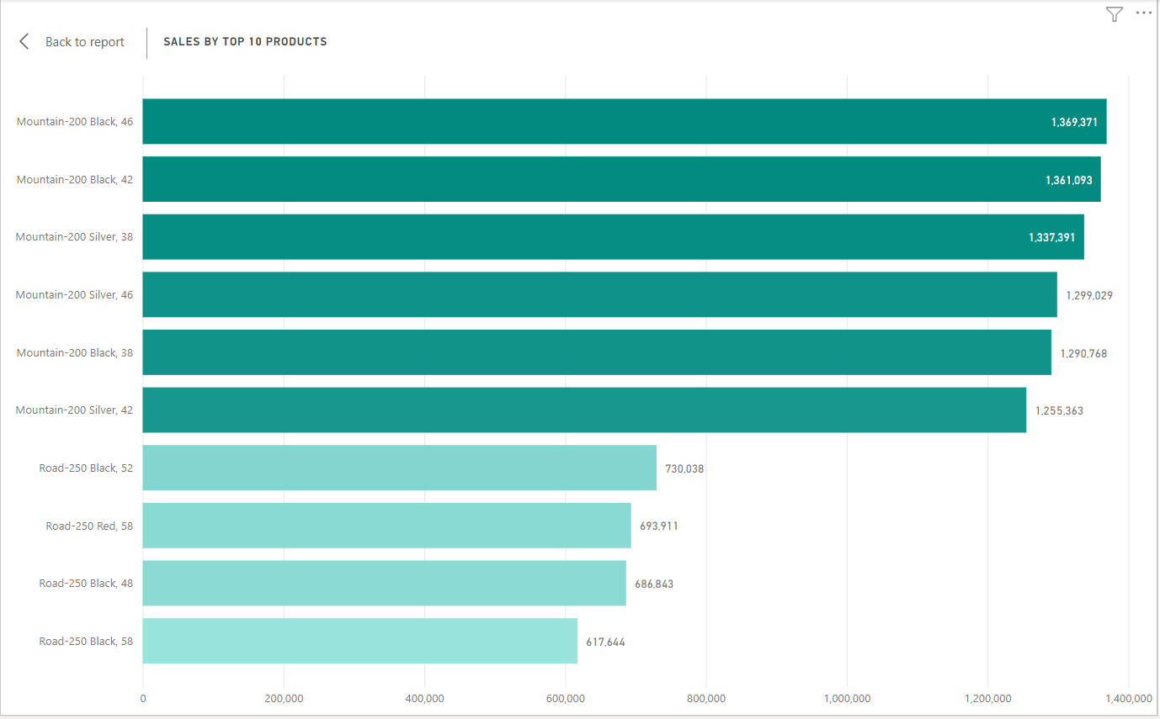
Top 10 Product Insights from CEO
Sales from top 10 products are from the bike category and was 10,641,452 which is 48 % of sales .
The company sales relies on a few products and can be affected by suppliers power.

Slide 15
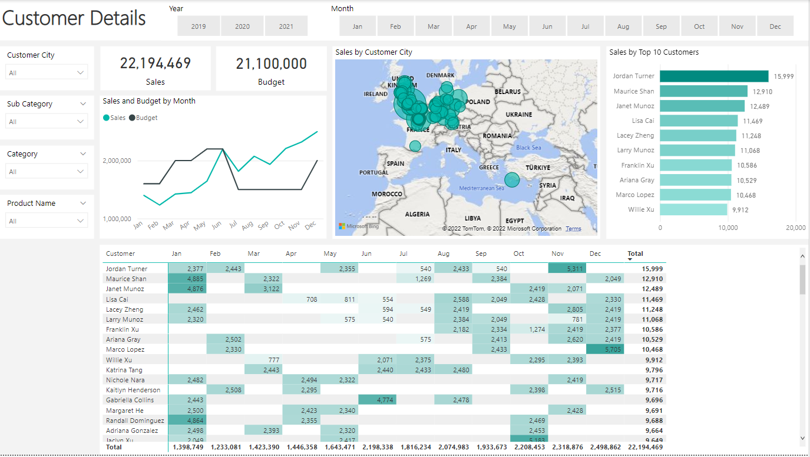
Customer Report for CMO

Slide 16
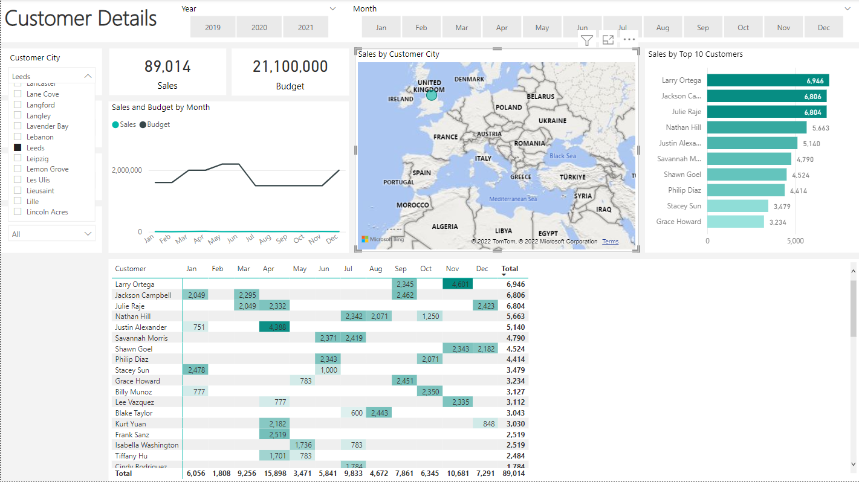
Customer filters
CMO can fliter customer by city as show Leeds customers generated 89,014 of sales revenue.

Slide 17
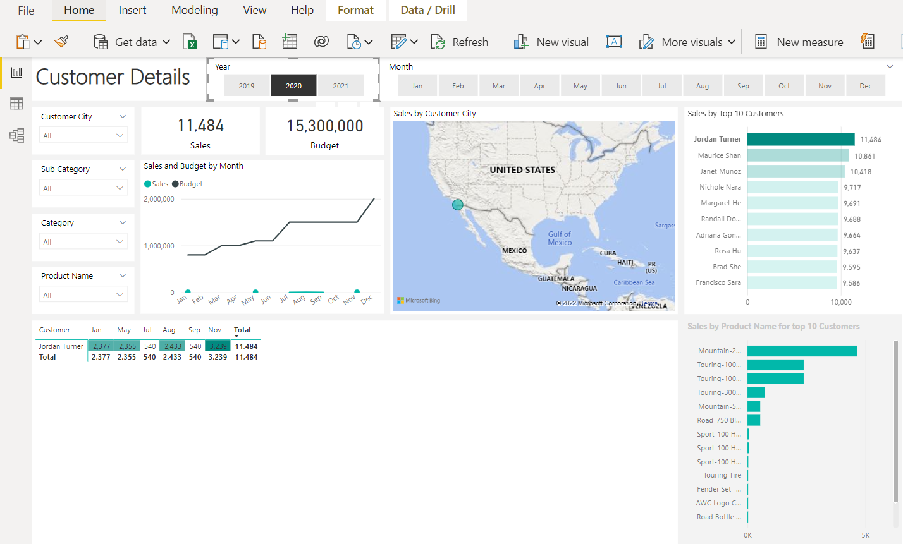
Filter by products bought by customer

Slide 18
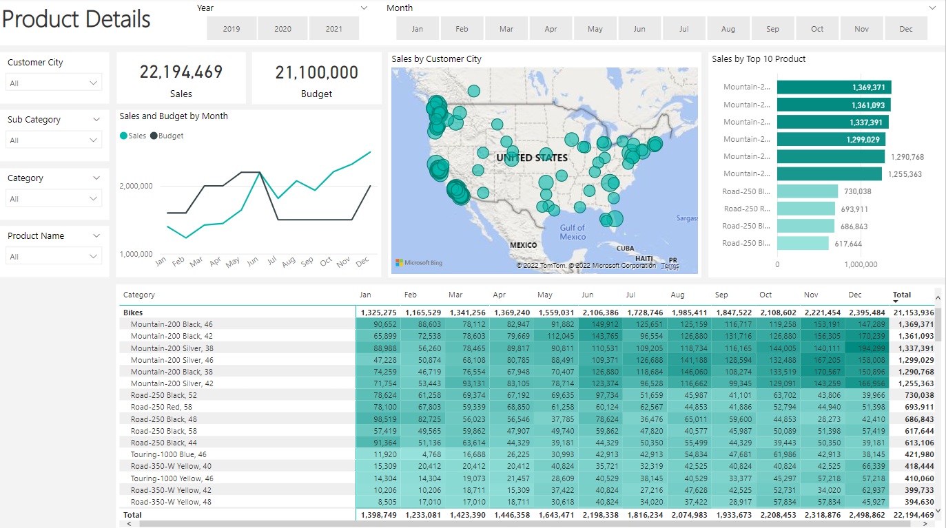
Product Report for CMO

Slide 19
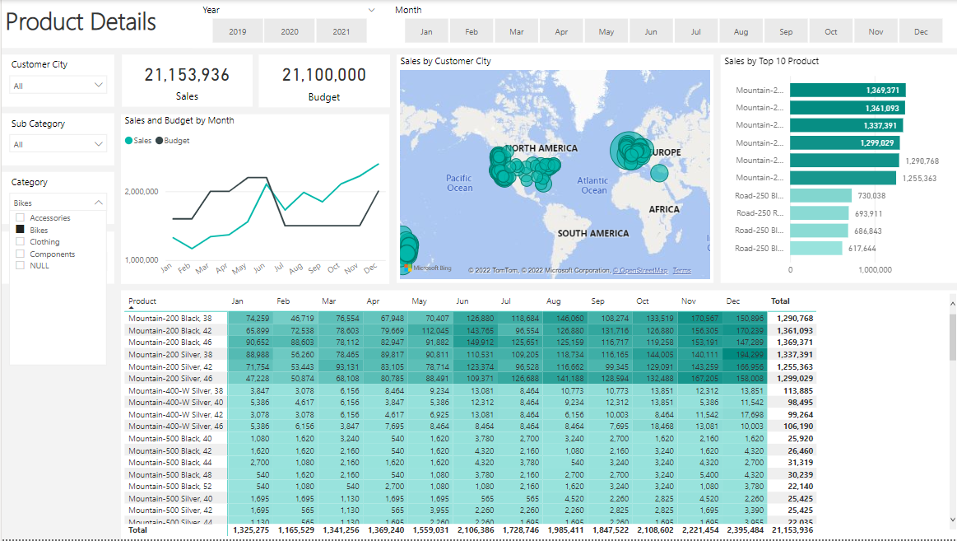
Filter by bike category
Contributed the highest sales of 21,153,936

Slide 20
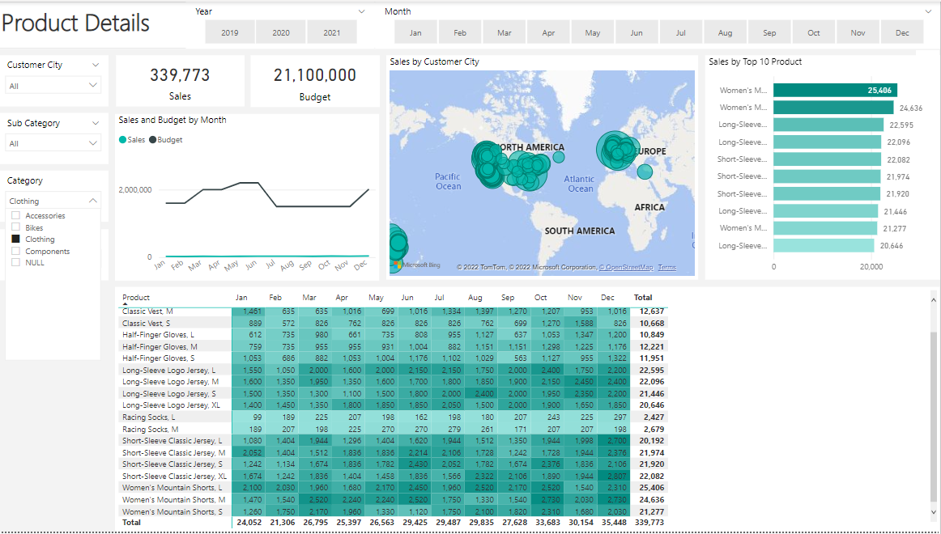
Filter by lowest product category
Clothing was lowest category having 339,773 for the period

Slide 21
Conclusion
I am sure my analysis have answered the business problems in question.
If you like to see anything in addition after you have digested this information, I am happy to develop that for you.
Thank you.

